Slide 1
Presenter：Huichao Ji
How many remembered items can we select at a time ?
2020.12.9 literature report
Notes:
储存在工作记忆中的表征，我们一次能选择几个？或者说一次能有几个与记忆模板匹配的刺激能够吸引我们的注意？

Slide 2
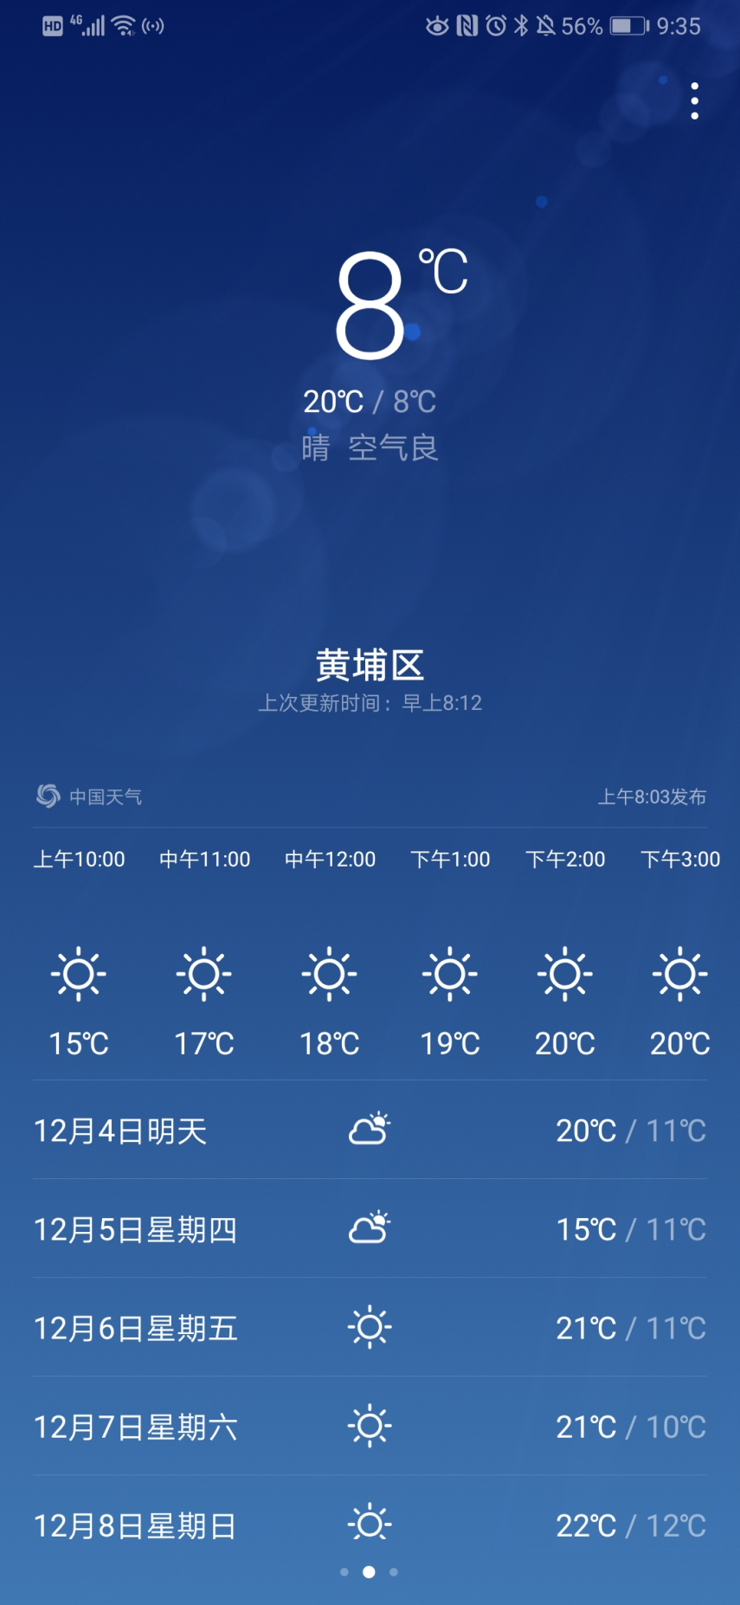

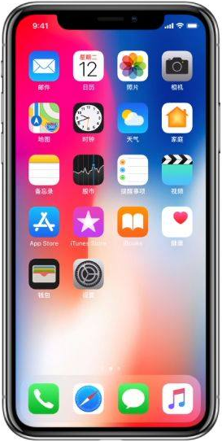

Notes:
这个例子不算完全贴切，但可以帮助理解
如何从长时记忆中选出最后的target

Slide 3
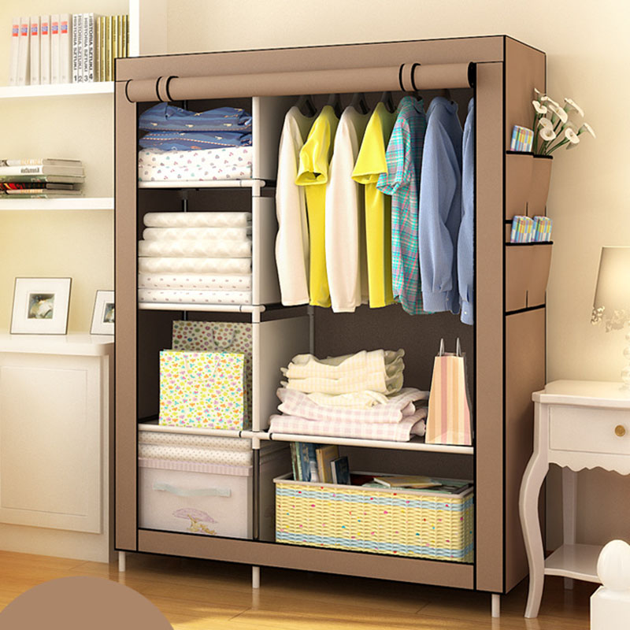

Slide 4
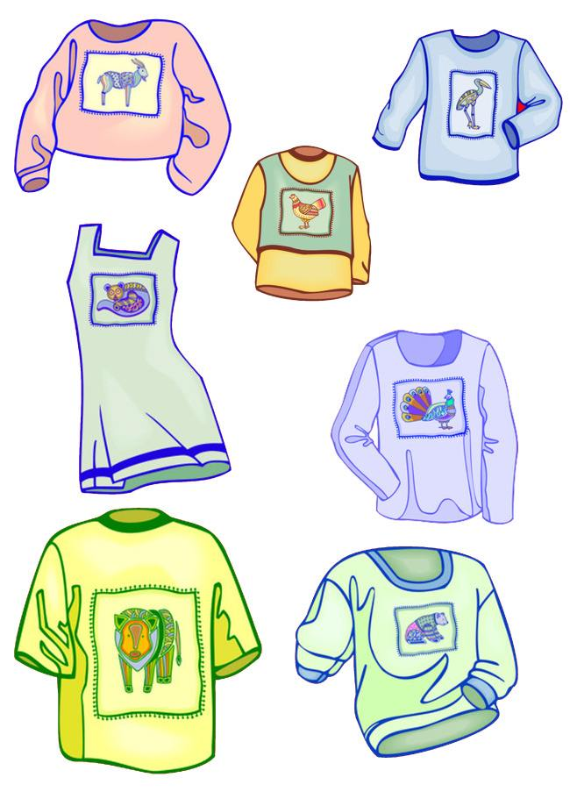

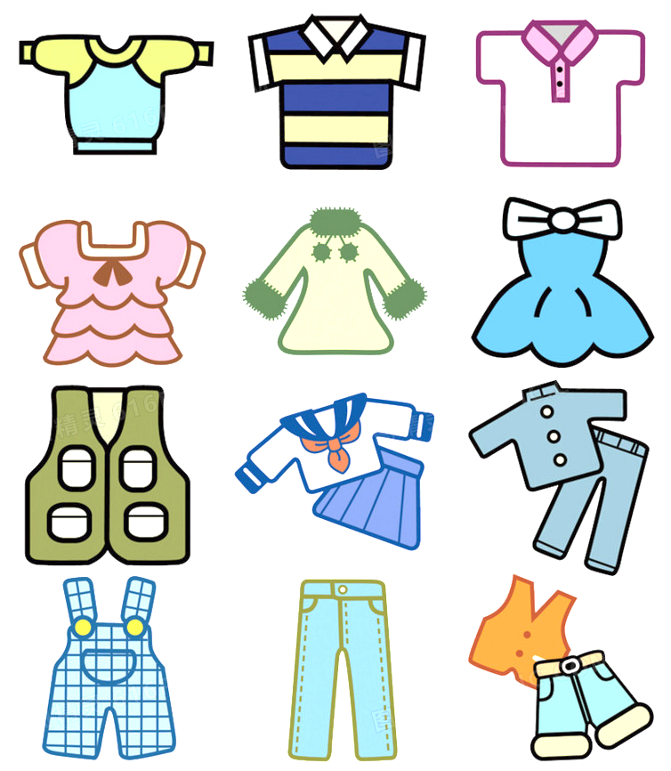
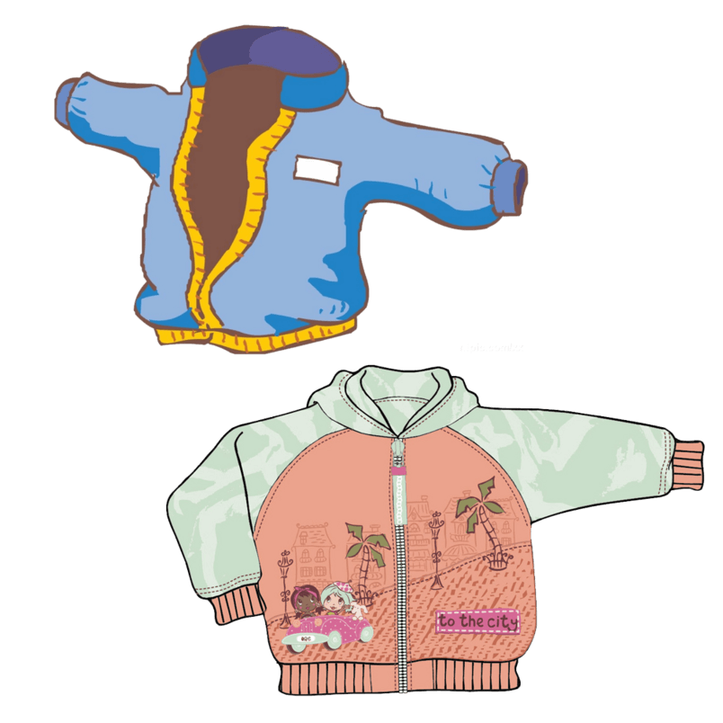


Slide 7
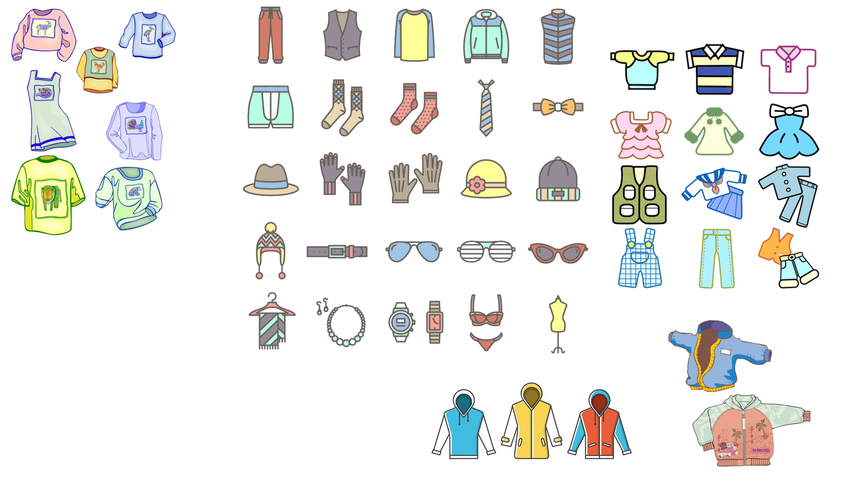
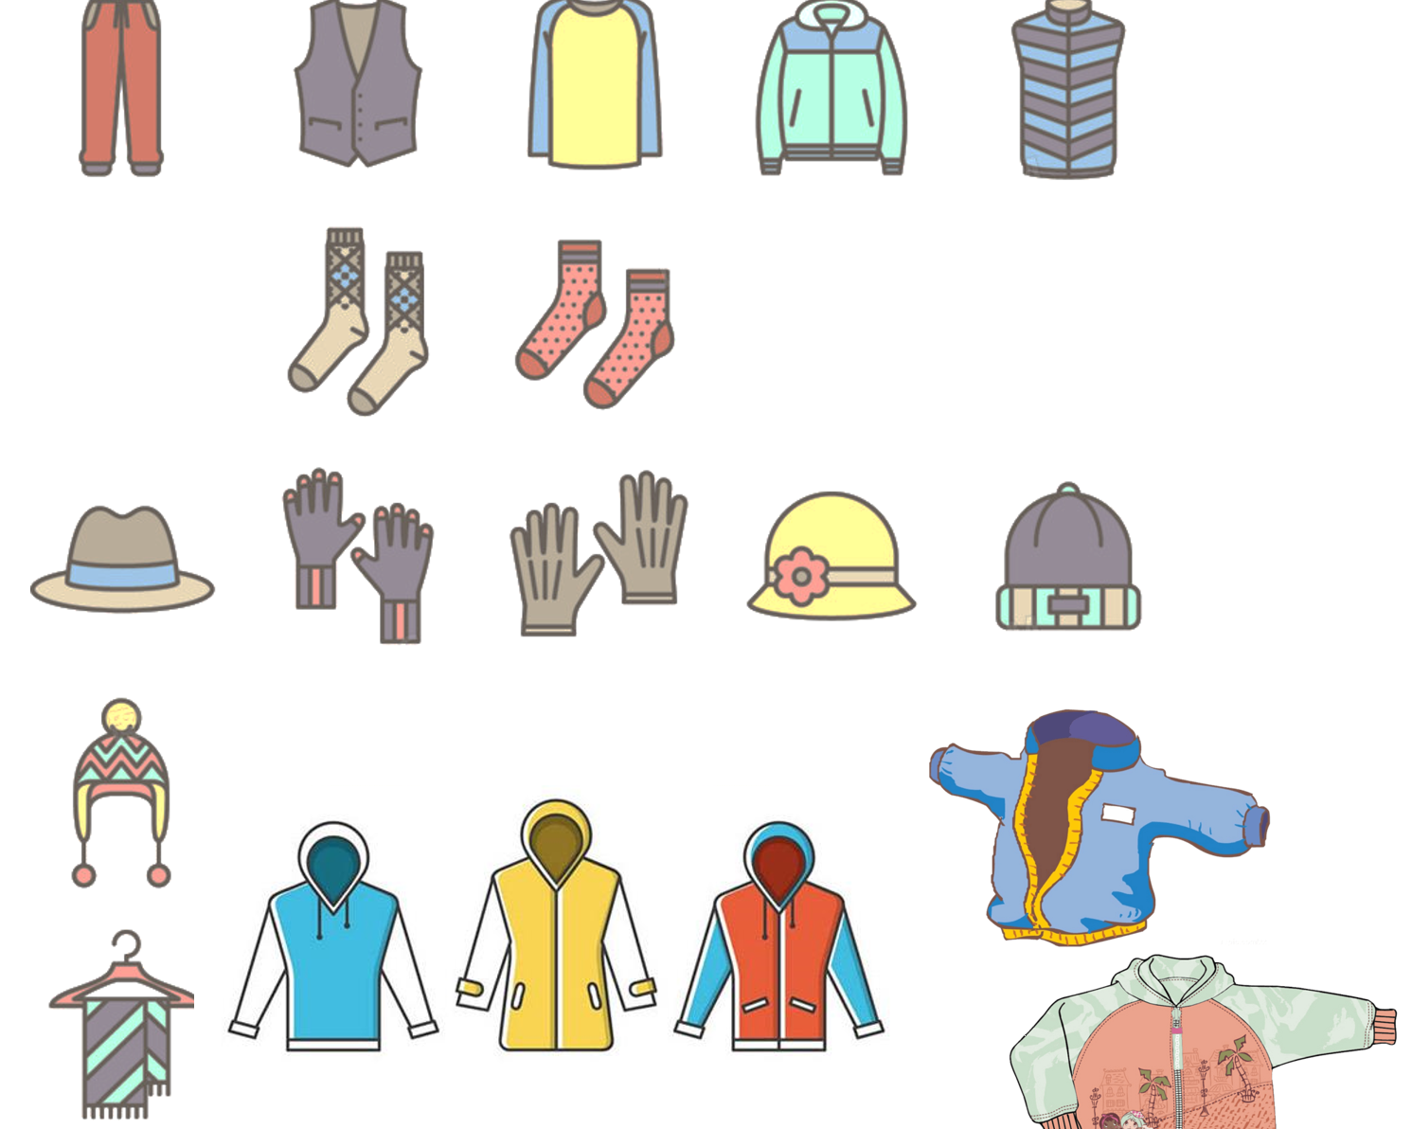
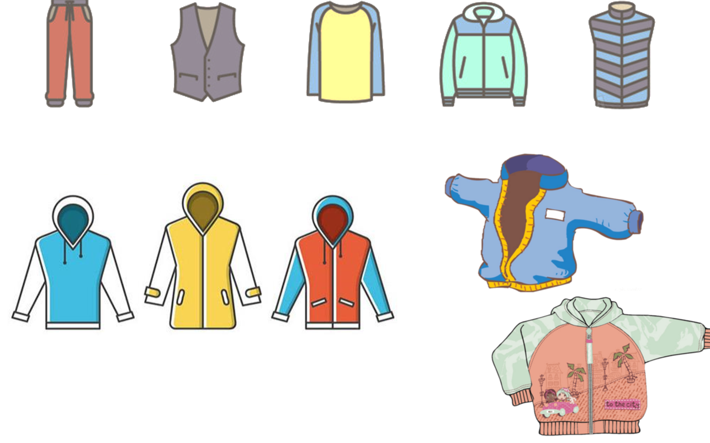
Embedded process model
Capacity -limited
Central
executive
Time
-limited
Four items
or chunks
Activated sensory and categorical features from long-term memory
Focus of attention
Long-term memory
(Cowan, 1999; Cowan, 2005)
Notes:
嵌套模型
为什么只讨论这两个模型？Shiffrin和Baddeley的呢？
-我们只讨论这两个明确表明与“注意”有关的模型
“Activated memory” → short-term memory
These activated memory fades unless by verbal rehearsal or continued attention
但是模型今天就不细讲了，我也没仔细看具体内容、性质什么的

Slide 8
Notes:
结合刚刚提到的模型，回到这个场景，我们再细想一下，foa真的能同时包含这些，并且实际上这些也都能同等程度地引导注意吗？或者说attentional template在某一时刻可以是一个还是多个？

Slide 9
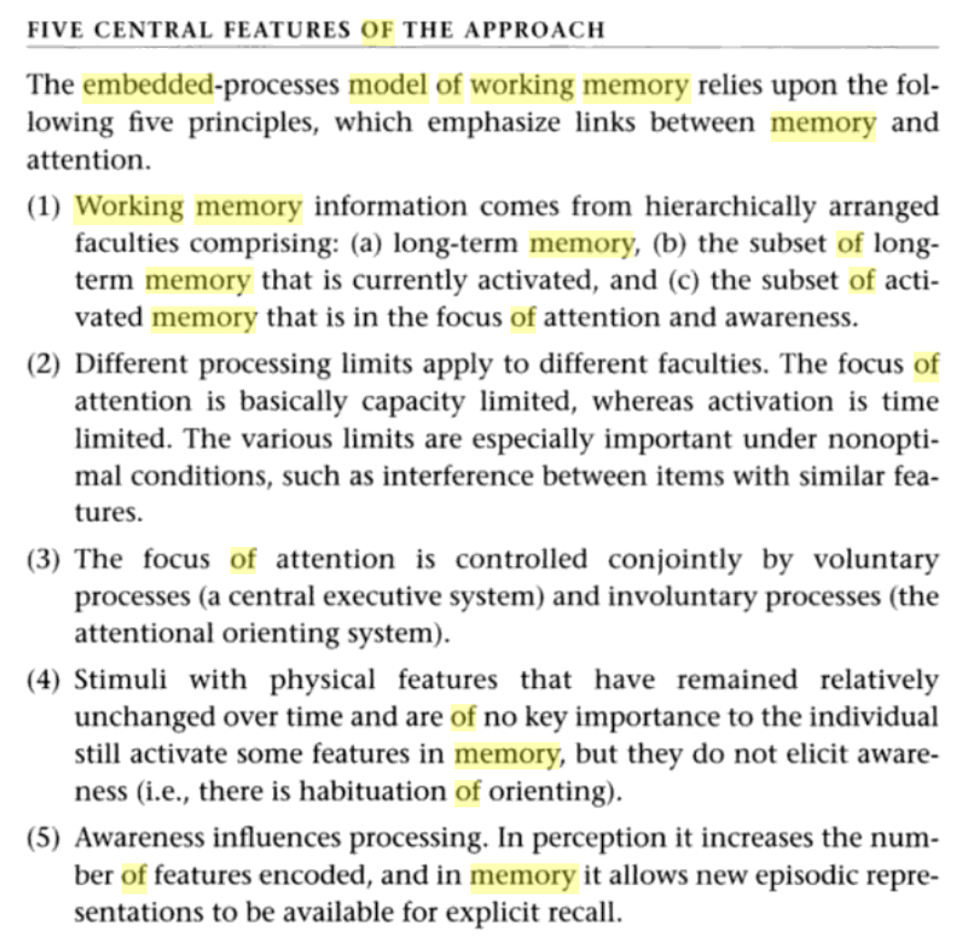
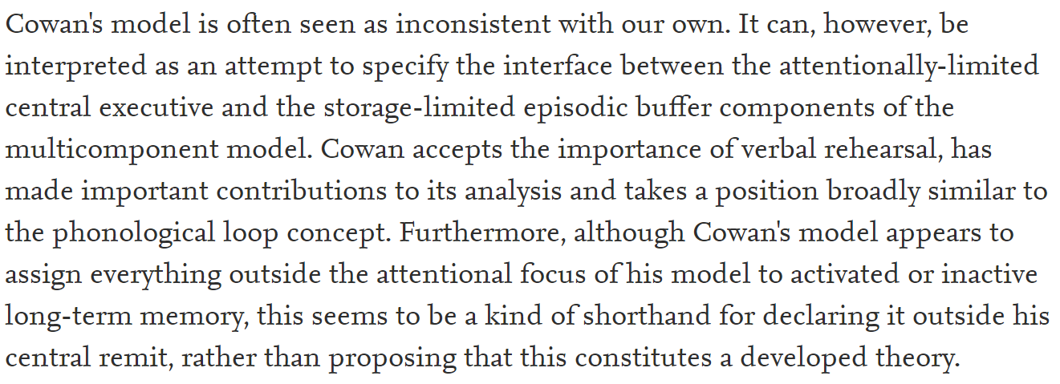

Notes:
Baddeley说到自己的模型与Cowan的模型时，说道：Cowan模型里的的FoA跟我们的情景缓冲器的capacity limit是一样的。但是总归来讲，其实用各种方式区别LTM和WM并不是最重要的，我们都更加关注LTM如何与WM交互

Slide 10
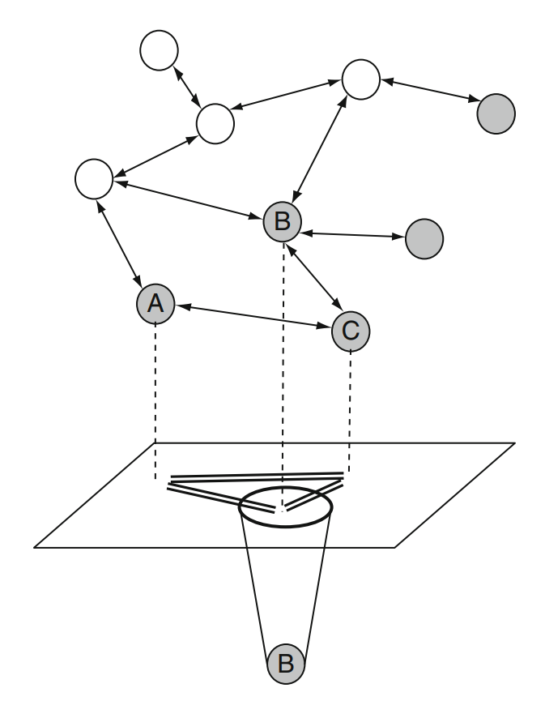
Concentric activation model
Representations in LTM
Direct access
(Capacity of WM)
Activated representations in LTM
Focus of attention
(selected for processing)
(a single item or chunk)
(Oberauer, 2009）
Notes:
同中心激活模型
这里把WM分为两部分，direct access+FoA
跟cowan不一样（cowan认为foa的容量就是WM的容量），这里认为direct access的容量是WM的capacity
所以其实这两个理论对于WM的capacity观点是一致的，但在focus of attention的个数上观点不一致
Only the single, attended item is maintained in a state that can directly interact with other, ongoing cognitive operations
实现表示各种信息之间的relation，虚线代表暂时的连接

Slide 11
WM
Attention (FoA)
How many representations in VWM can be maintained in an active state to simultaneously guide attention ?
How many remembered items can we select at a time ?
Notes:
Whether attention can be strategically guided by multiple items in VWM simultaneously

Slide 12
Logic of research
Visual attention
Stimuli matching WM items in the FoA
Notes:
Visual attention is directed to stimuli matching working memory items in the focus of attention,
we can infer which items in working memory were being selectively attended

Slide 13
single-item-template hypothesis
2
multiple-item-template hypothesis
Notes:
1、one item is maintained in the active template state; other items in VWM are in an accessory state that is inert with respect to attentional guidance (i.e., they do not interact with attentional priority maps to influence selection)
2、multiple items can be maintained in an active state that interacts with attentional selection, predicts minimal or no switch costs.

Slide 15
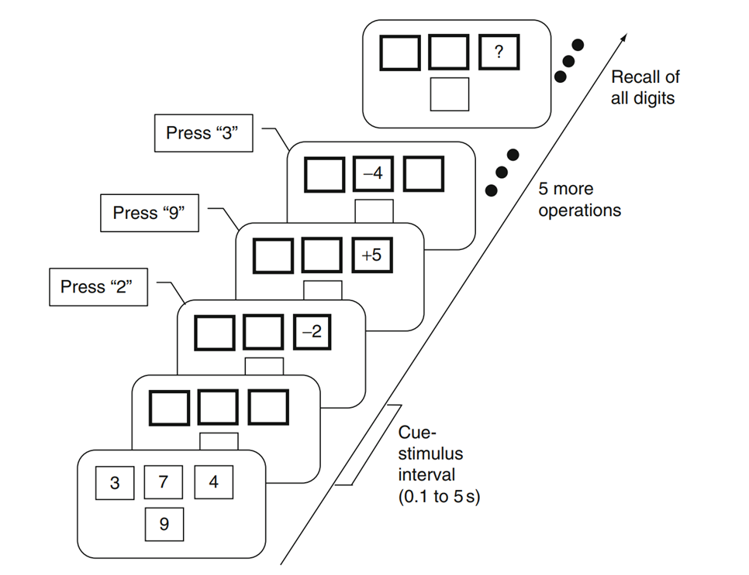
Switch cost
Notes:
在支持sit的研究中，经典的一个指标就是switch cost
左图，记住，并对相应的item进行运算，最后还会test原来的记忆项

Slide 16
Switch cost
3
7
4
9

Slide 17
Switch cost

Slide 18
Switch cost
-2
2

Slide 19
Switch cost
+5
9

Slide 20
Switch cost
？
9

Slide 21

Oberauer (2002)
or
3
7
4
2
5
9
or
Notes:
左图，记住，并对相应的item进行运算，最后还会test原来的记忆项

Slide 22
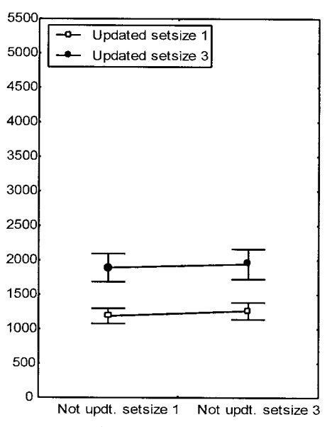
Results
RT (ms)
Notes:
在正确率都比较高的条件下
只有updated set size主效应显著，not updated set size主效应不显著，交互不显著
（set size=3的时候算的是平均反应时）

Slide 23
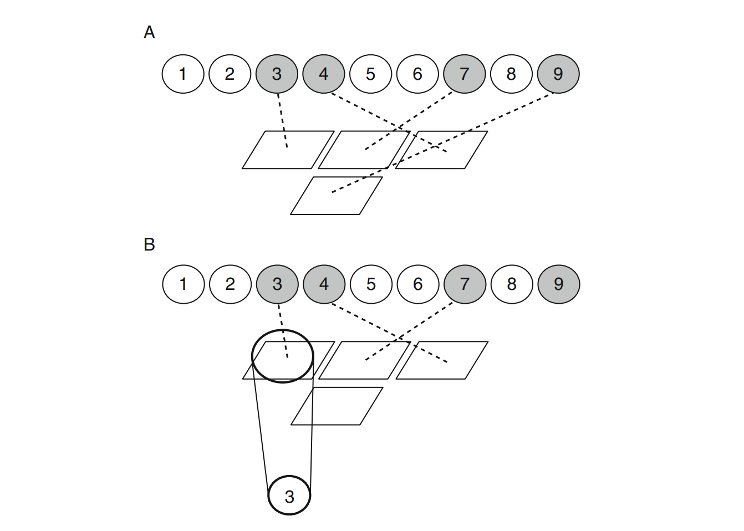
Switch cost
Concentric activation model
Notes:
再拿同中心激活模型来对比的话，3479对应模型中的变灰的，347对应ABC，3对应B
但根本没让同时注意两个，所以并未解决什么问题

Slide 24
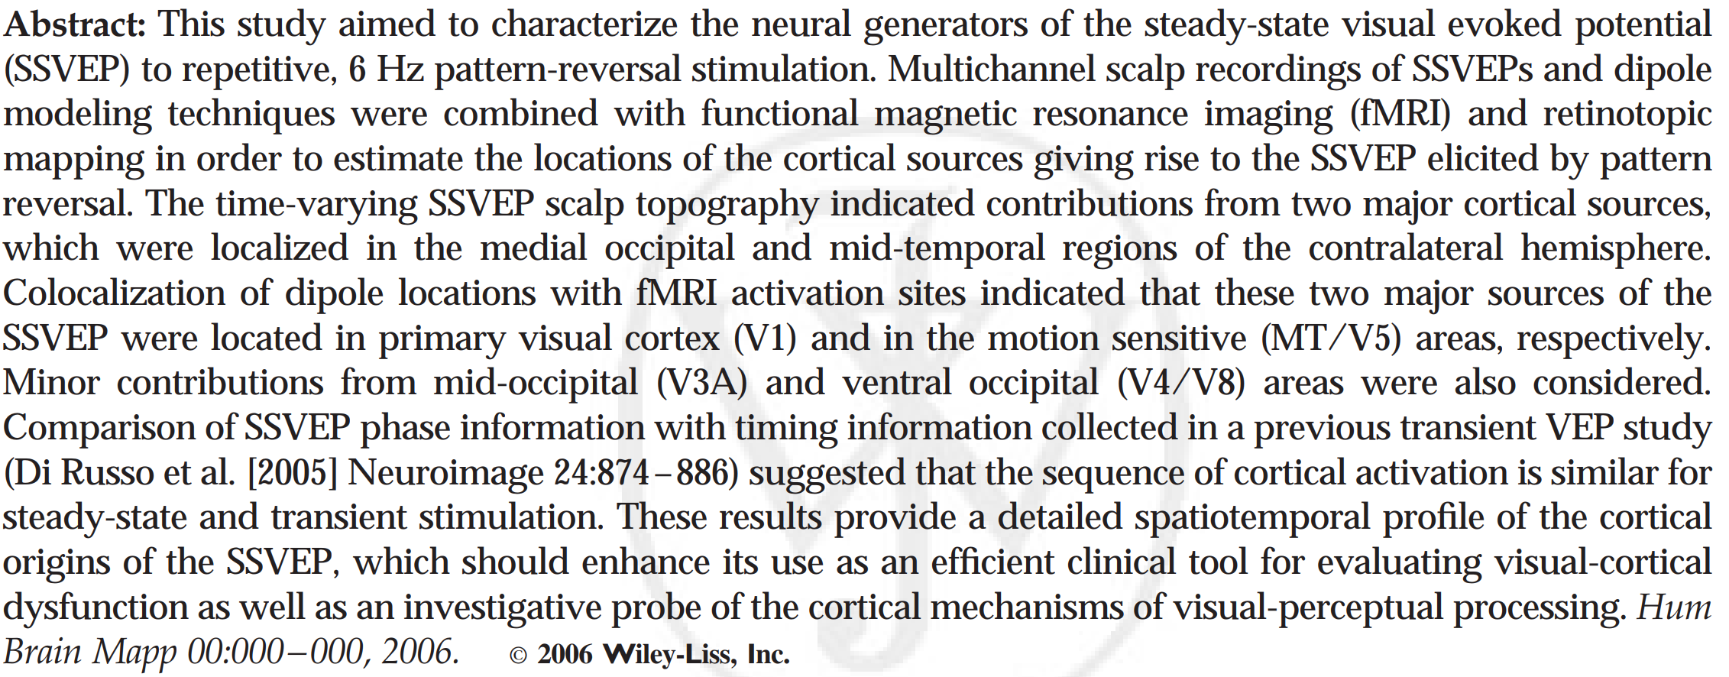

Steady-state visual evoked potential (SSVEP)
Di Russo, F., Pitzalis, S., Aprile, T., Spitoni, G., Patria, F., Stella, A., . . . Hillyard, S. A. (2007). Spatiotemporal analysis of the cortical sources of the steady-state visual evoked potential. Human Brain Mapping, 28, 323–334.
Notes:
稳态视觉诱发电位

Slide 25
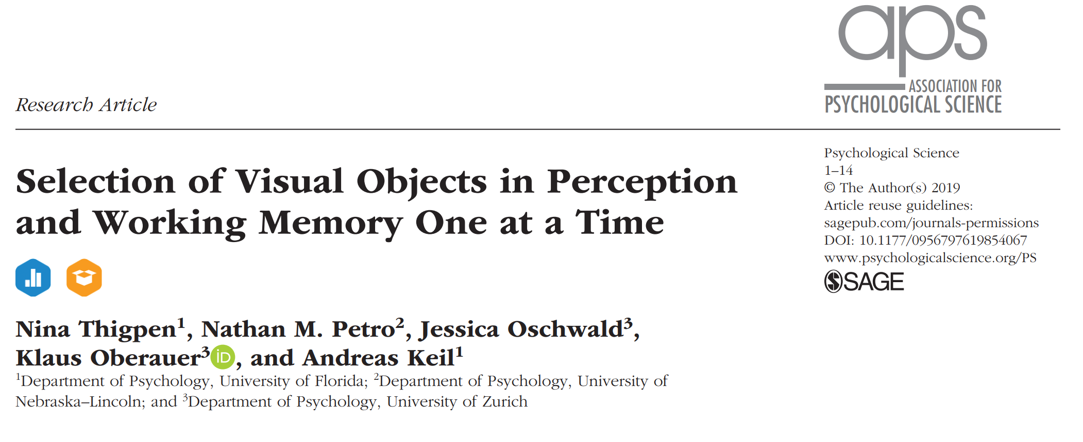

Slide 26
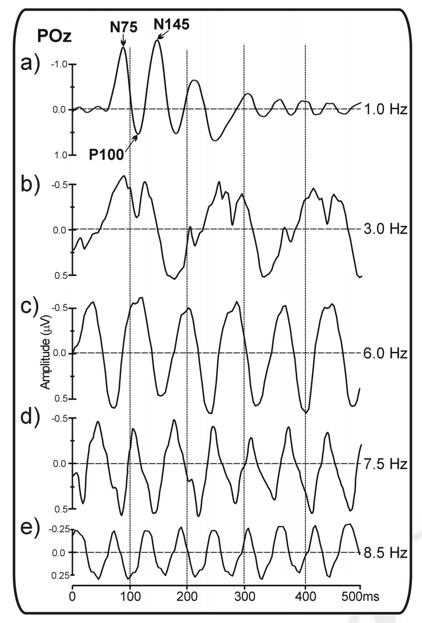
Steady-state visual evoked potential (SSVEP)
V1/MT/V5 areas
Minor contributions from mid-occipital (V3A) and ventral occipital (V4/V8)
Transient visual evoked potential (VEP)
！
SSVEP
(Di Russo et al., 2007)
Notes:
除了行为实验，最近也有一篇利用SSVEP这个脑电指标的支持SIT的研究
瞬态脑电信号我们可以看到常见的脑电成分，当刺激呈现的频率大于6Hz时，V1区的脑电会以(一倍或两倍于刺激呈现频率) 对应的频率，表现出一个正弦态，从而我们可以使用frequency tag来区分视皮质对于不能用普通脑电成分区分的刺激的的反应！

Slide 27
Thigpen, Petro, Oschwald, Oberauer, & Keil (2019). Selection of visual objects in perception and working memory one at a time.
1.
?
Attentive selection of stimuli matching an item in WM
SSVEP
2.
The fate of the unmatched, competing stimulus
?
3.
The visual cortex
Simultaneously amplify the features of two items held in WM
?
Notes:
被试量：大学生 Experiment 1 (N = 16), Experiment 2 (N = 20), or Experiment 3 (N = 20)
1. Does the attentive selection of stimuli matching an item in working memory affect activity in visual cortex as observed in the SSVEP response to probes ?
2. When one of two perceptual stimuli matches an item in working memory, what is the fate of the other, competing stimulus?
3. Does the visual cortex simultaneously amplify the features of two items held in working memory?

Slide 28
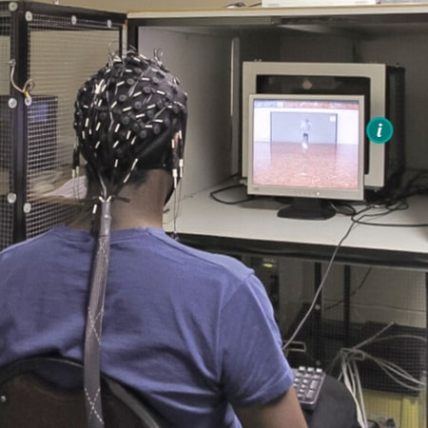
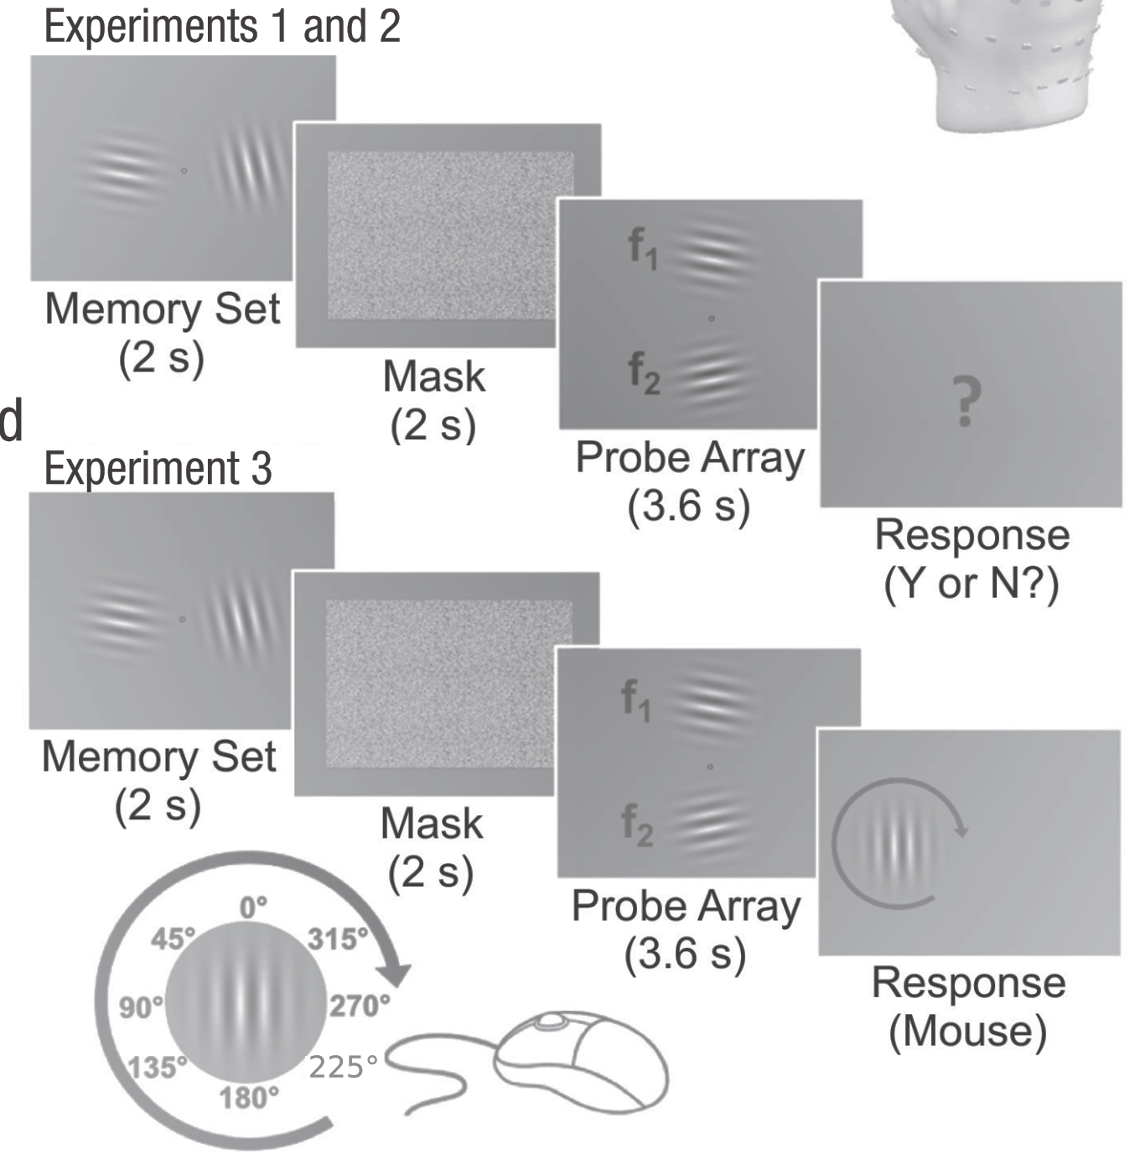
Experiments
Press any
key to start…

Slide 29
·
Notes:
3~4s

Slide 30

·
Notes:
Remember the orientations，2s
竖直方向±12°、36°、84°

Slide 31

·
Notes:
Mask, 2s

Slide 32
·
Notes:
Probe array, 3.6s

Slide 33
?
Notes:
Response, Y or N

Slide 34

10Hz & 13.3Hz
Press “←“ or “→”
Making probe array task irrelevant
Notes:
反相变化：两个的变化峰值是交替出现的？？？
一半被试是上10hz下13.3hz，另一半被试是反过来的
左右键对应的YorN也是在一半中反过来对应
Exp1：no matching probe (48 trials) or one matching probe (52 trials).
Exp2&3: 26 upper-match trials, 26 lower-match trials, 26 both-match trials, and 62 no-match trials
Exp3: 让probe array变得与任务无关，看能否依旧捕获注意

Slide 35
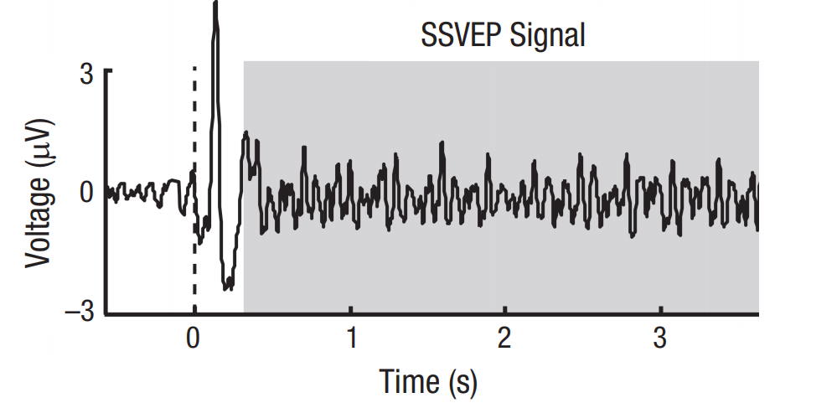
SSVEP signal
Exclusion of the visual onset potential, occasional offset events (blinks, anticipatory responses)
300ms
3300ms

Slide 36
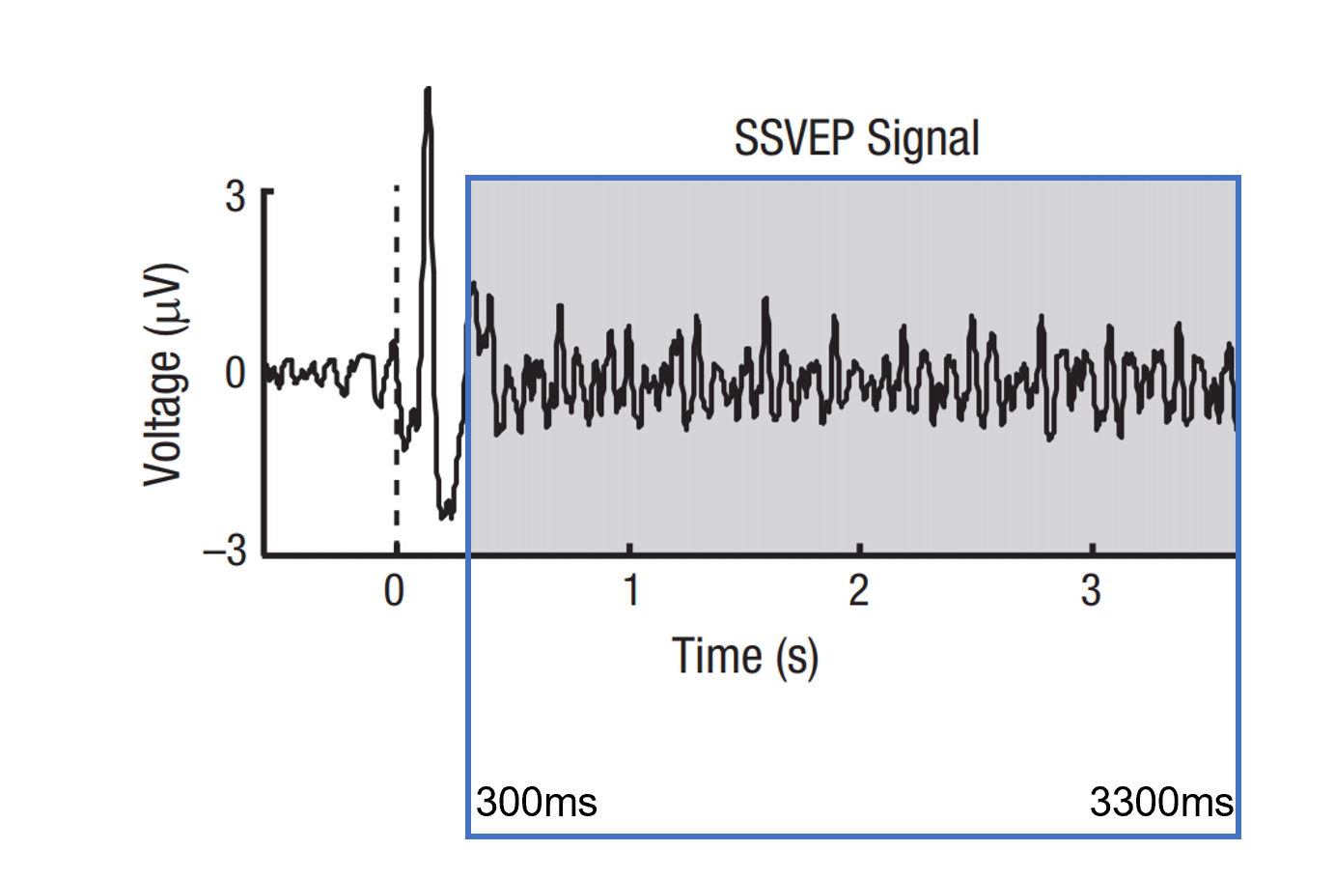
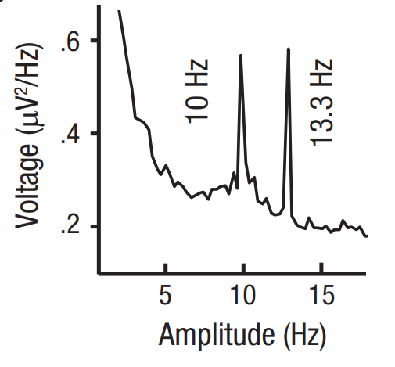
SSVEP signal
Fourier transformation
SSVEP power
Notes:
经过傅里叶转换，由时域分布得到频域分布（这个图是所有人所有trial的平均）
那么每个电极在每个条件下的某个频率的SSVEP power 就都可以从频域分析中提取出来，之后分析具体是用的Oz+与Oz距离最近的三个点的平均
实验一就是看这些频率和对应频率的gabor在power上是不是一致，也就是test 我们算的SSVEP power能不能代表激活
傅里叶证明任何波形都可以通过将一组不同频率、振幅、相位的正弦波相加来重构，经过傅里叶变换可以算出每个频率的正弦波在重构ERP波形时所需要的振幅/功率（振幅的平方）（所以这里的纵坐标为啥又除了一个hz？？？
滤波就是把频域分布乘以对应的频率响应函数，然后再逆傅里叶变换得到滤波后的时频分布

Slide 37
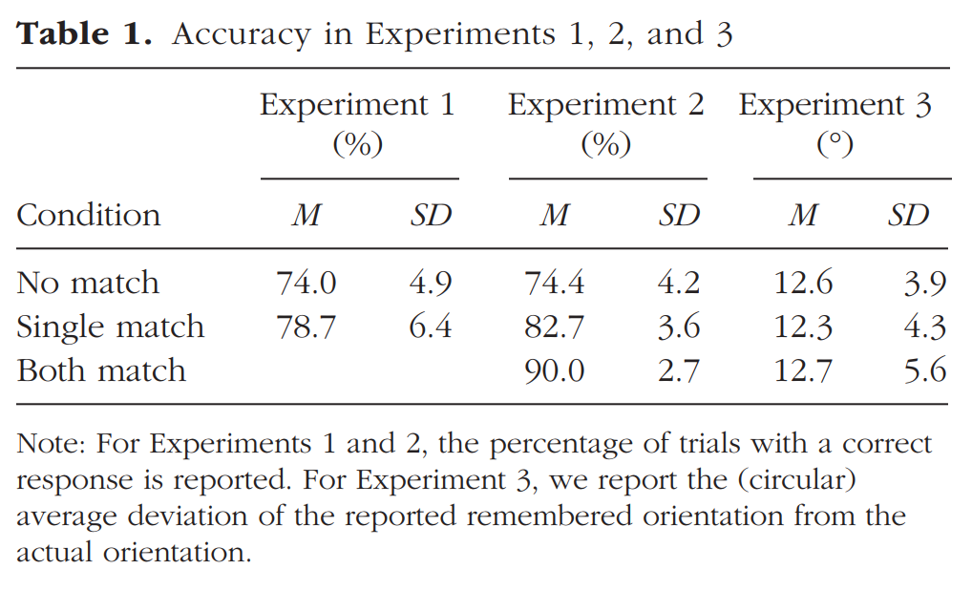
Results
Notes:
但没有进行统计分析，因为：
在Exp1，no match对应的正确反应是no，single match对应的正确反应是yes，任何反应偏向都会影响分析结果；
在single match和both match中，both match看到匹配gabor的概率更大，做对的概率自然更大，所以进行统计分析也没有意义
这里对Exp3的反应进行分析没有发现任何差异，显而易见，毕竟这里的反应跟probe的match 不match没有关系…
所以这一屏，其实，没啥意义…..

Slide 38
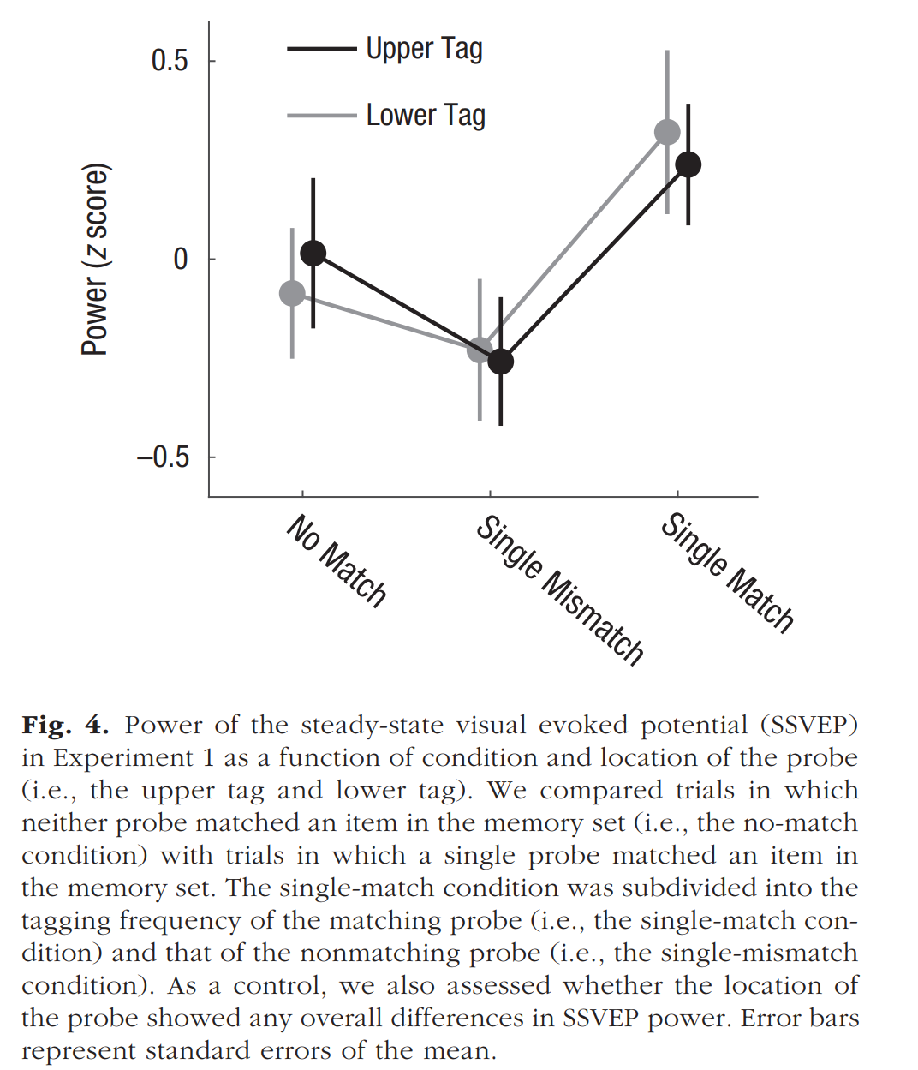
Results_Exp1
match
mismatch
Notes:
除了主要结果：power能够代表与WM中一致的item有带来的激活（这个power是标准化后的）
此外，还有一个有趣的现象：相对于两个都不match的条件，有一个match的条件里的mismatch的那个出现了抑制（suppressed）
这里其实就很显然可以排除model1和model2了
No match要更多，为了防止反应偏向，因为我们要着重分析match的trial

Slide 39
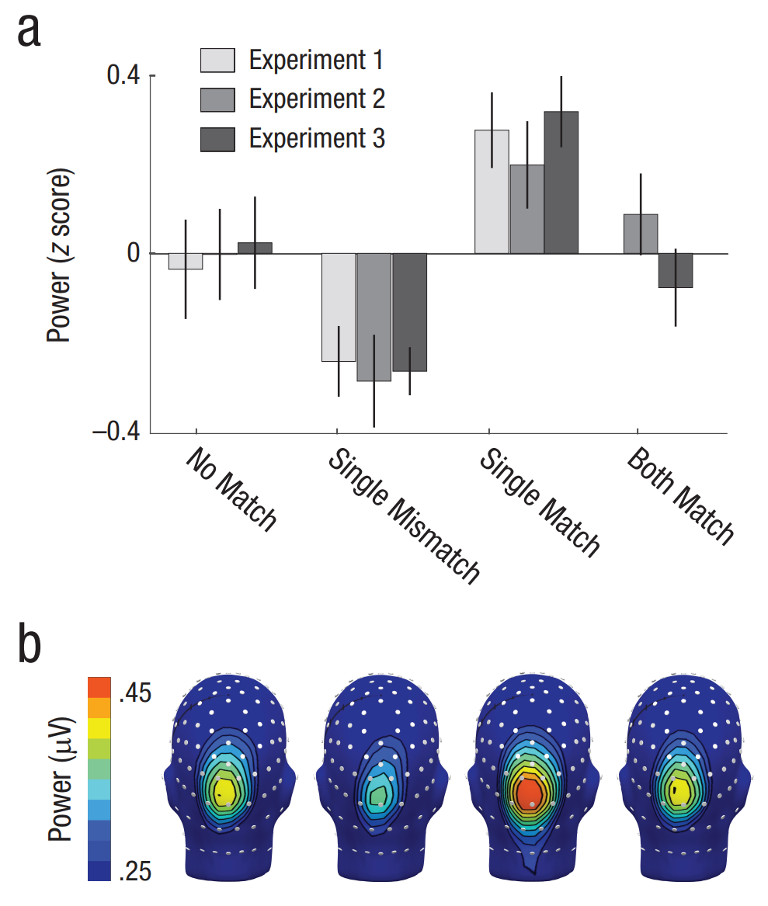
Results
Notes:
后面两个实验其实也获得了一样的结果
下面的四个头对应上面的四个条件（both match是没有区分到底是哪一个的，是上下两个的平均）
大致看一下Both match条件的结果，其实也可以看出不能同时选择两个match items，具体分析见下一部分
为什么选Oz？

Slide 40
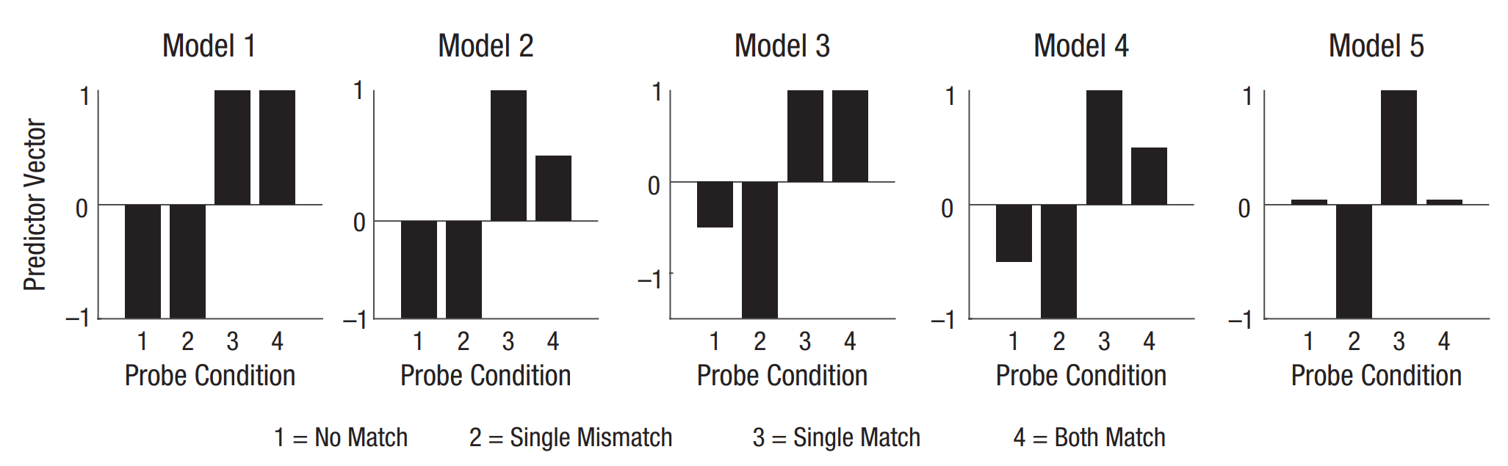
Five Bayesian linear mixed-effects models
Unlimited capacity | limited capacity | unlimited capacity | limited capacity | One at a time
Selecting one probe would not suppress the other | Selecting one probe would not suppress the other | Selecting one probe would suppress the other | Selecting one probe suppresses the other | Selecting one probe suppresses the other
Notes:
实验一证实了SSVEP的有效性，那么注意到底是怎么分配的呢？
实验二数据：👇
将no match作为基线
分层模型（？？）
每一种条件有一个对应的预测变量，表示注意的分配
预测变量越大，表明该条件能够引起的SSVEPpower越大
1：两个match的平均和一个match是一样的，single mismatch和no match处于平和的稍低值
2： 两个同时match，那么每一个会activate less，mismatch的会被suppress
3：mismatch的会被suppress
4：两个同时match，那么每一个会activate less
5：可能存在来回切换，一会儿被增强，一会儿被抑制（这个之后会分析）
4和5的差异在于，在both match的条件里，其中一个有时是被suppress还是只是activate less（即会不会抵消，进而接近no match的水平）

Slide 41
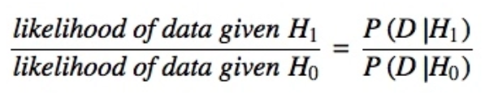
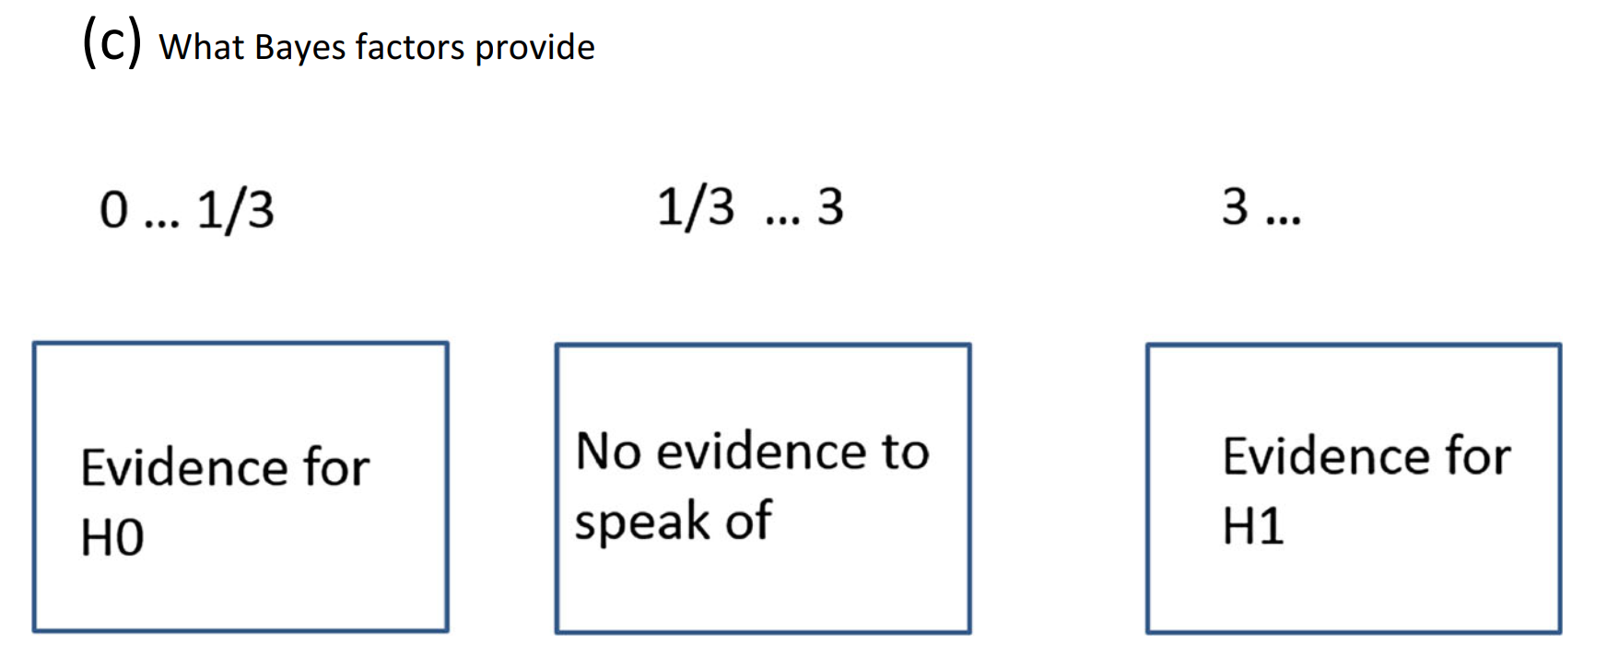
Bayes factor
BF =
(Dienes & Mclatchie, 2018)
Notes:
五个嫌疑人跟无辜的人进行对比

Slide 42
Five Bayesian linear mixed-effects models
BF factor：
152 1149 3864 15549 474838
Notes:
用实际SSVEP Power的数据进行拟合后进行模型比较得到贝叶斯因子
每一种模型跟零假设模型 (a null model (M0) with a random intercept only) 比较都能得到贝叶斯因子
Model5：perceptual attention has limited capacity, attention alternates between stimuli when two stimuli are functionally relevant, and the stimulus not
currently selected is suppressed.
两个贝叶斯因子相除，可以得到：Model 5 should be regarded as 30 times more probable than Model 4
实验三得到了相似的结果

Slide 43
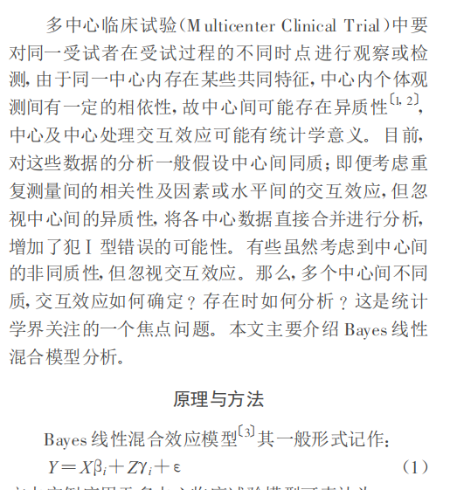
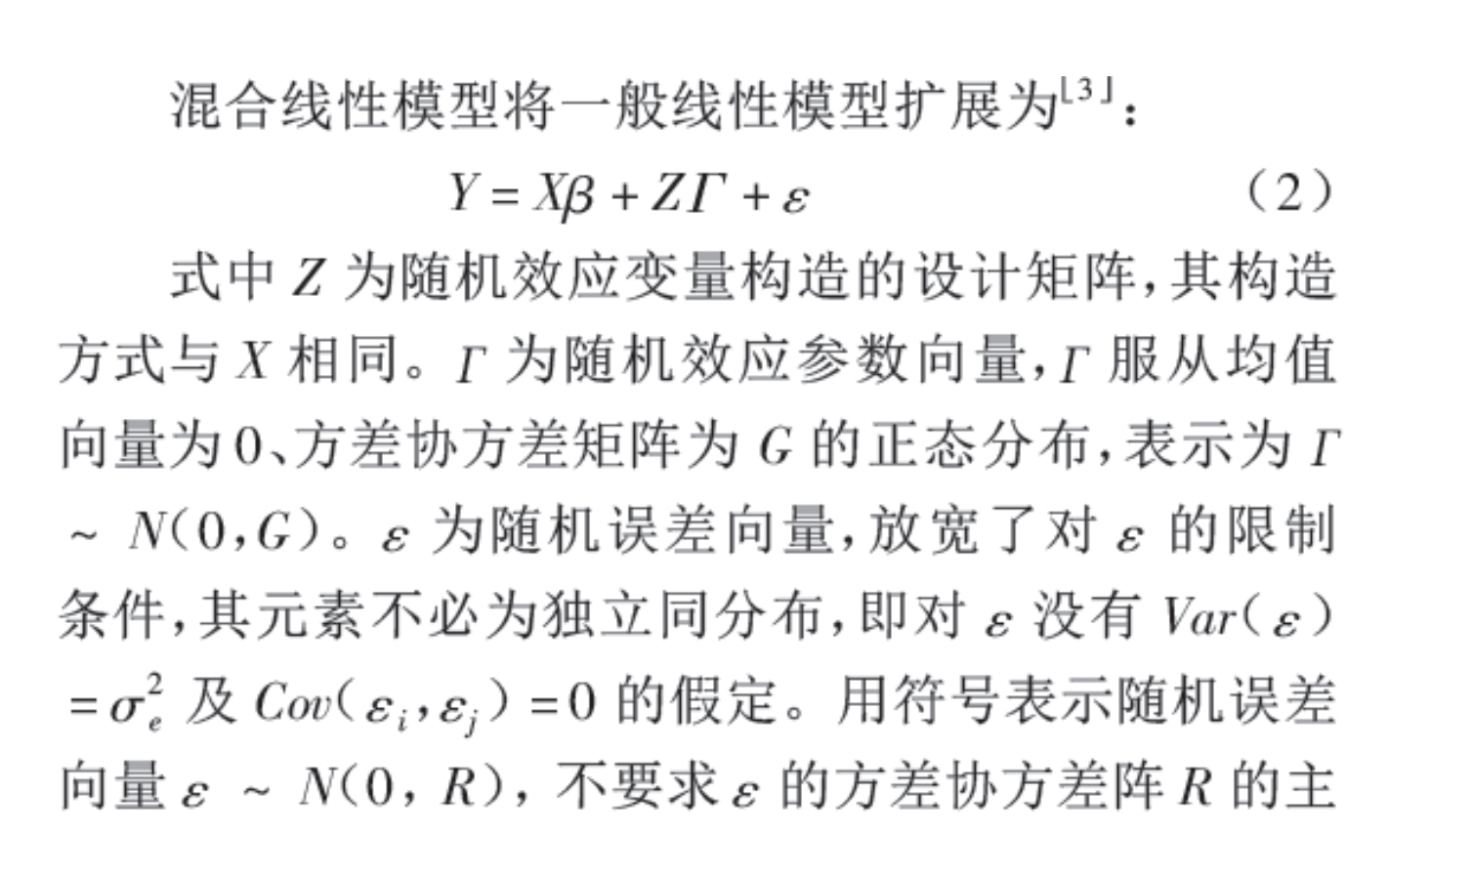
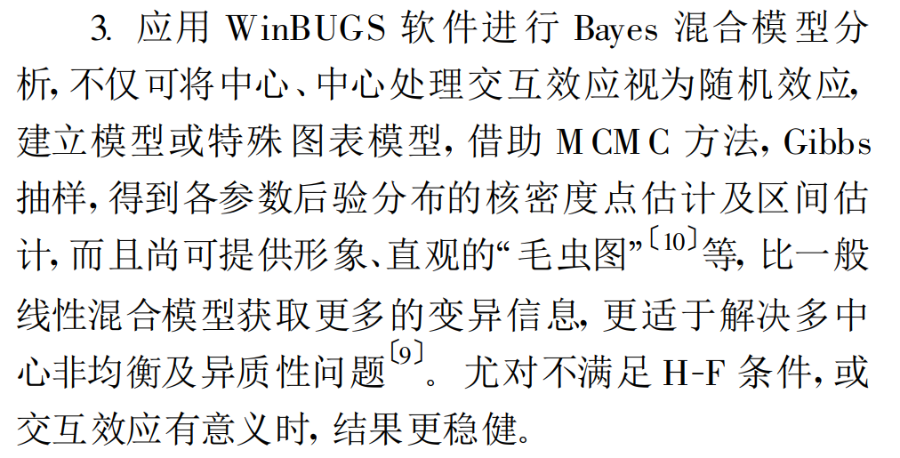

Slide 44
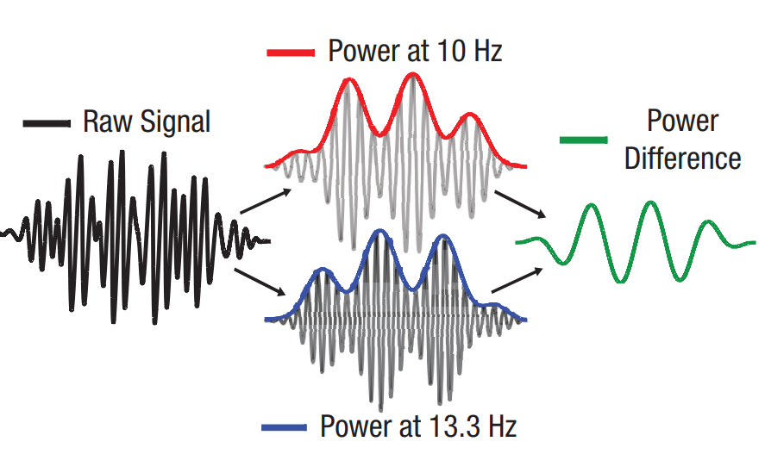
Single-trial selection index
Notes:
模型5中nonmatch和bothmatch的值一样，我们怎么能确定真的是我们想的那种来回切换呢？
之前power是没有时间信息的，这里使用希尔伯特变换分别得到了10HZ和13.3HZ的SSVEP power随时间变化的曲线
选择指数（代表在两个item之间的切换）表现出了波动
If attention switches back and forth between two stimuli, then the SSVEP amplitudes
of the two stimuli should be negatively correlated over time:
For each time point, we computed the difference of the neural response to the two concurrent stimuli as an index of selectivity. A negative correlation between these responses over time implies that the selectivity index fluctuates over time

Slide 45
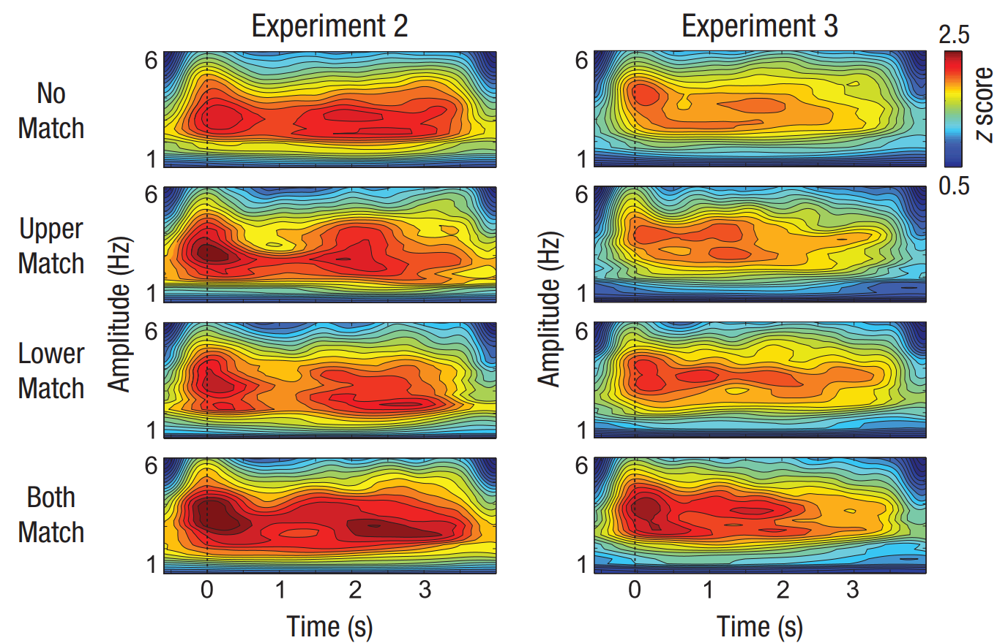
Single-trial selection index
Notes:
选择指数集中在3~4hz，并且在各个条件中都有这种切换（但切换并不意味着power的绝对值哦，这也是一个神奇的地方，虽然power没有，但却也有切换？）

Slide 46
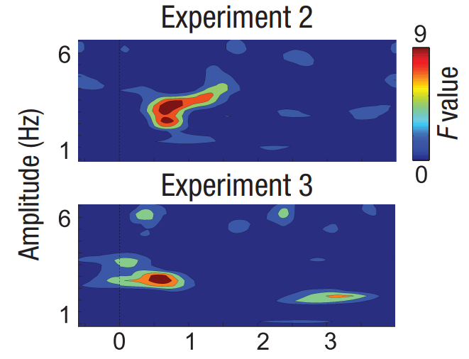
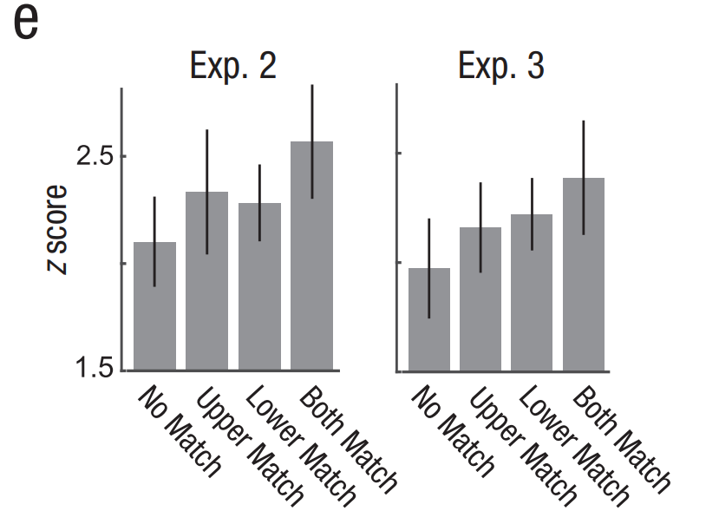
Single-trial selection index
Notes:
比较两个实验中的各个条件的selectivity差异，发现集中在3~4HZ，以及1s之内，
进一步比较发现，虽然在各个条件中都有这种切换，但我们把selectivity的power标准化后进行比较（z score代表切换的频率），会发现在两个都match的condition里，振荡程度是最大的
而在实验三发现的相同结果，说明即便是任务无关时，这种注意分配也会发生

Slide 47
A serial, single-item attentional sampling of remembered features
3~4Hz
Matching probes prompted an increased visuocortical response
whereas mismatching stimuli were suppressed
Notes:
When two memory items were probed simultaneously, visuocortical amplification alternated between the two
stimuli at a rate of 3 Hz to 4 Hz
总结：两个都跟WM match的item都会有增强的视皮质反应，但并不是同时的，会存在3~4Hz频率的切换
一次只能选择一个！

Slide 48
2

Slide 49
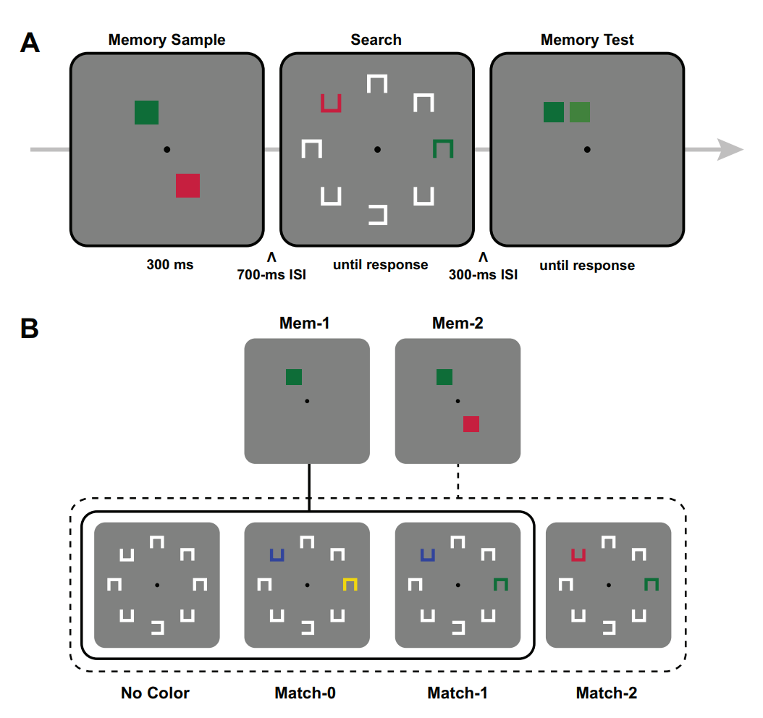
Attentional capture

Slide 50
Attentional capture
·

Slide 51
Attentional capture
·

Slide 52
Attentional capture
·
←

Slide 53
Attentional capture
·
←

Slide 54
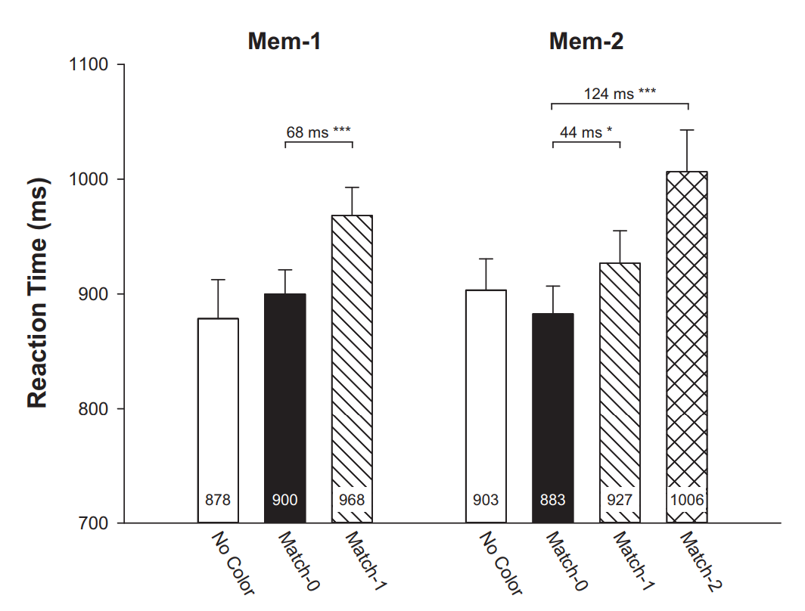
Attentional capture
(Hollingworth & Beck, 2016)
Notes:
任务：找到水平开口的，然后判断是朝左还是朝右
如果是SIT，只有一个能捕获注意, 那么Mem-2里面，Match1和Match2应该没有区别

Slide 55
Bahle, B., Thayer, D. D., Mordkoff, J. T., & Hollingworth, A. (2019). The architecture of working memory: Features from multiple remembered objects produce parallel, coactive guidance of attention in visual search
Inconsistent results
Switch cost？
Differences in their absolute levels of activity (or priority)
Notes:
作者指出，其实对方阵营里的switch cost在很多研究里都没有发现，表明可能是MIT；
即便发现了switch cost，也有可能是MIT，只是不同item激活/优先性的绝对值不一定完全相同而已

Slide 56
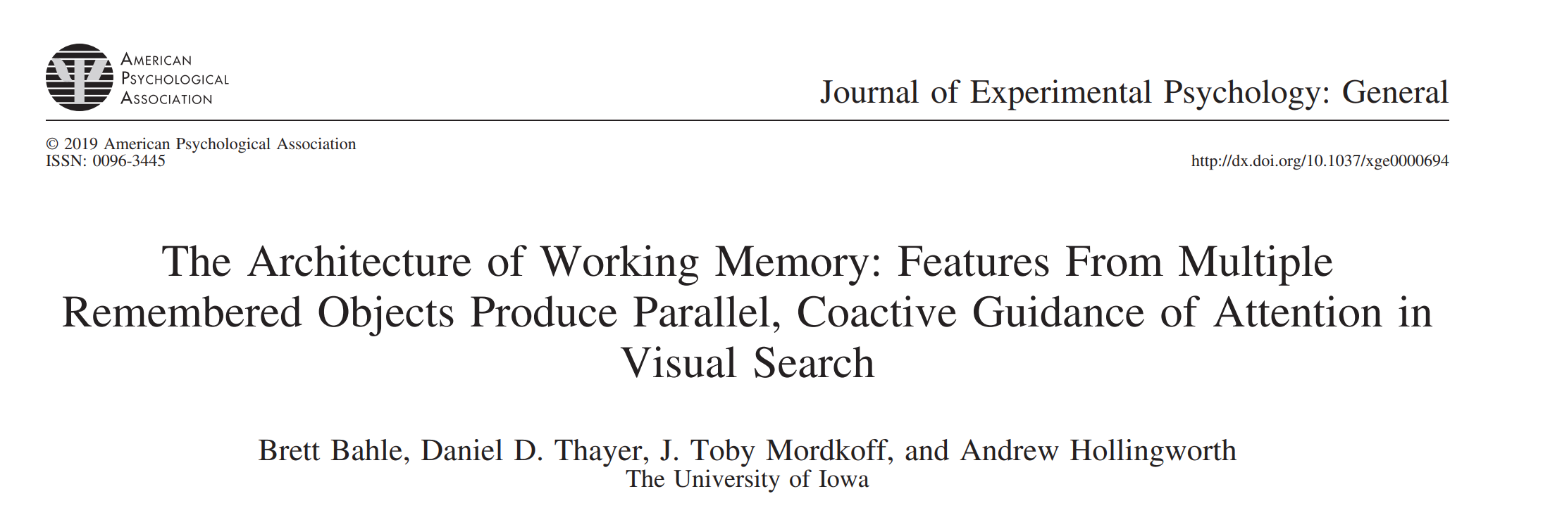

Slide 57
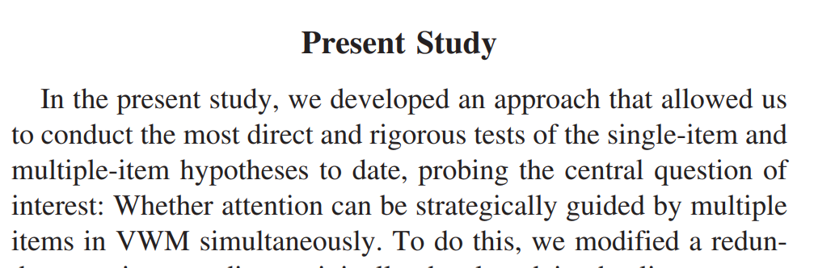
Bahle, B., Thayer, D. D., Mordkoff, J. T., & Hollingworth, A. (2019). The architecture of working memory: Features from multiple remembered objects produce parallel, coactive guidance of attention in visual search

Slide 58
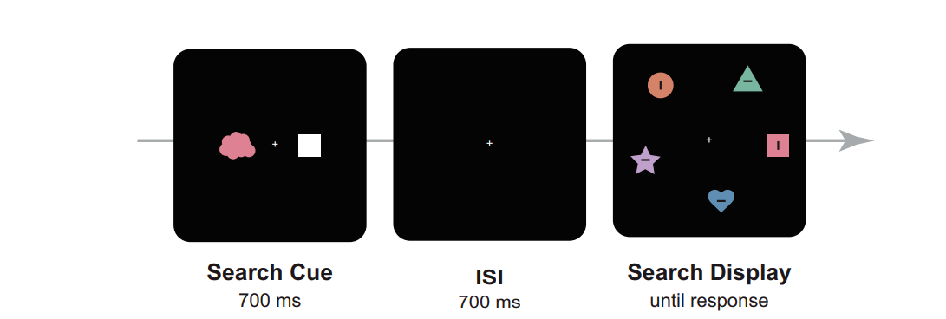
Methods

Slide 59
+

Slide 60
+

Slide 61
+

Slide 62
+

Slide 63
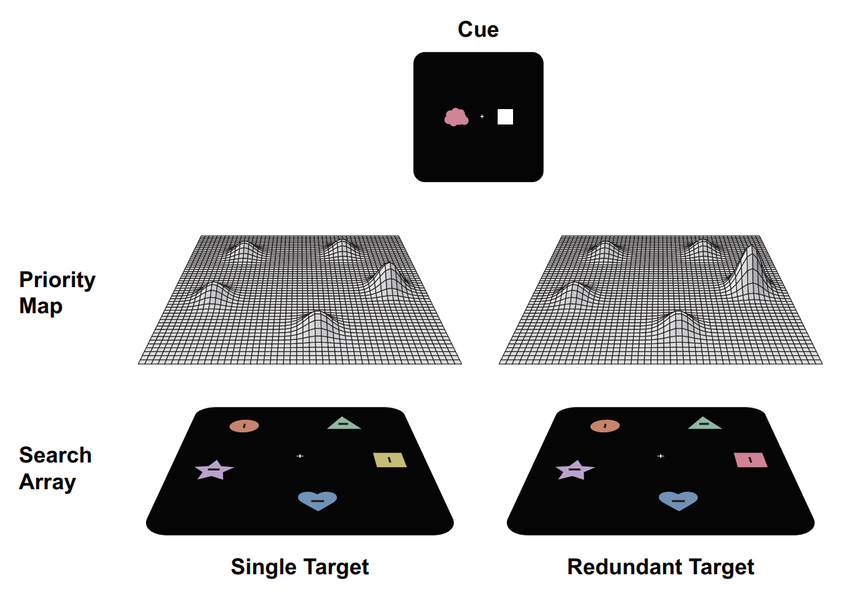
Models
redundancy gain
serial model
Separate activations model
(race model)
parallel model
coactive model
Notes:
序列：一次一个
平行1：平行但独立，两条平行线，互相竞争吗，看哪个能更快引导注意
平行2：平行但不独立，总的priority是两个priority的综合作用，会产生一个大于单个match的priority
但需要注意的是，三个模型首先都同意redundancy gain，即两个match的trial要比单个更快，但我们需要分析的是到底快多少，怎么个快法

Slide 64
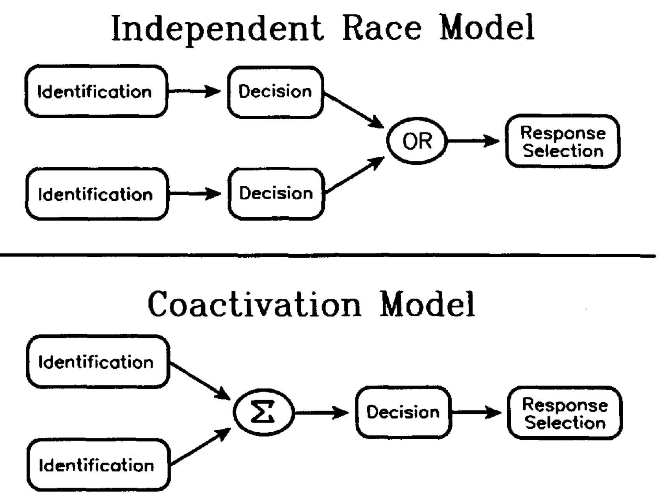
(Mordkoff & Yantis 1991)

Slide 65
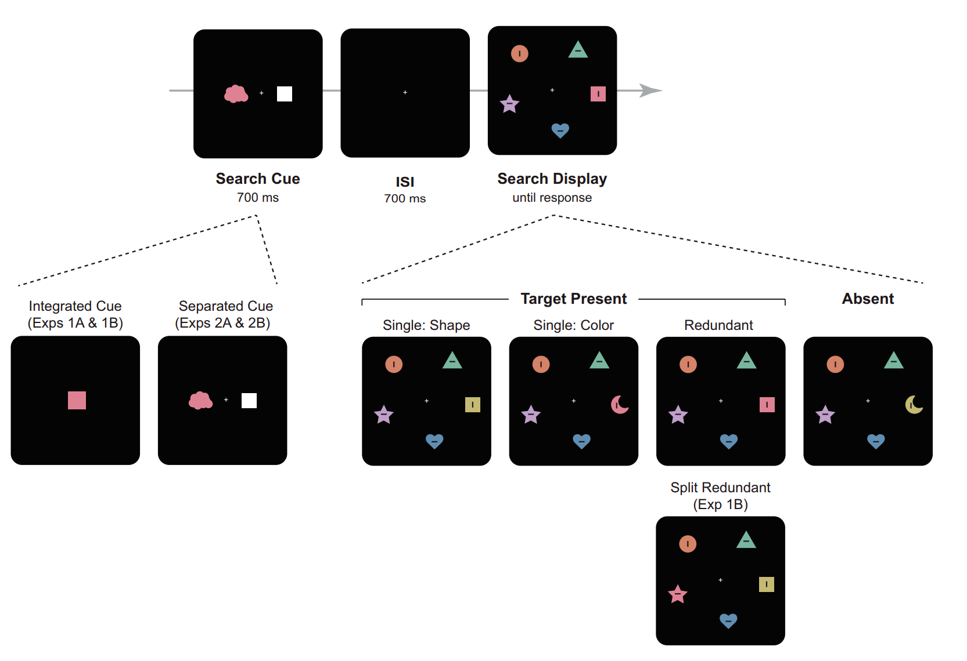
Experiment 1 A&B

Slide 66
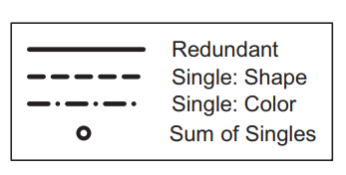
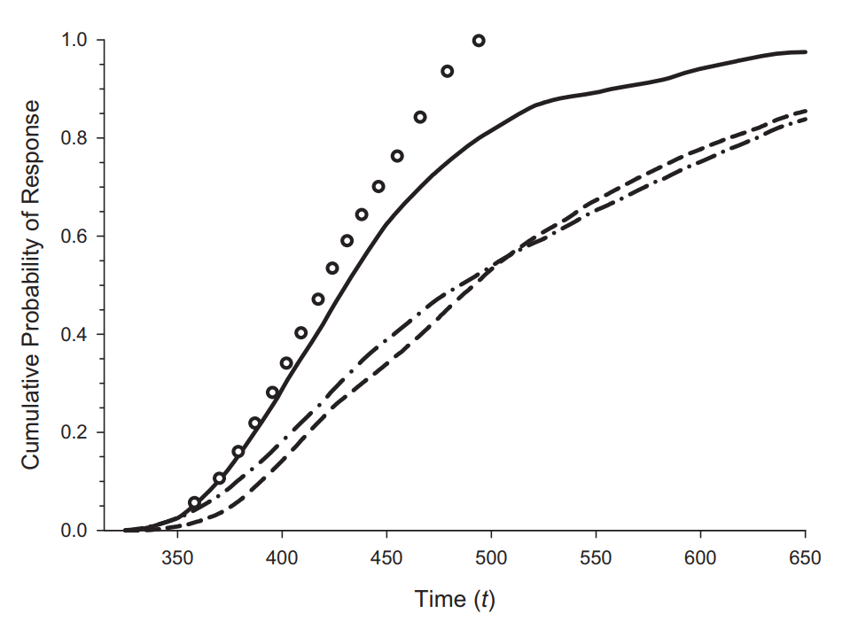
Serial/ separate activations model (race model)
Race model inequality
(RMI)
p(RT < t |two-feature trial) ≤ p(RT < t |color-match trial) + p(RT < t |shape-match trial)
Notes:
RMI：Miller (1982)
p(RT < t|two-feature trial) ≤ p(RT < t|color-match trial) + p(RT < t|shape-match trial)
两个p的加总会给redundancy gain设一个上限
累积分布函数表示在该时间点前反应的概率

Slide 67
Serial/ separate activations model (race model)
p_{R} = 1-(1-p₁)(1-p₂)
= p₁+p₂-p₁p₂
=p₁+p₂(1-p₁)
=p₂+p₁(1-p₂)
p_{R}
p₁
< p₁+p₂
p₂
> p₁
> p₂

Slide 68
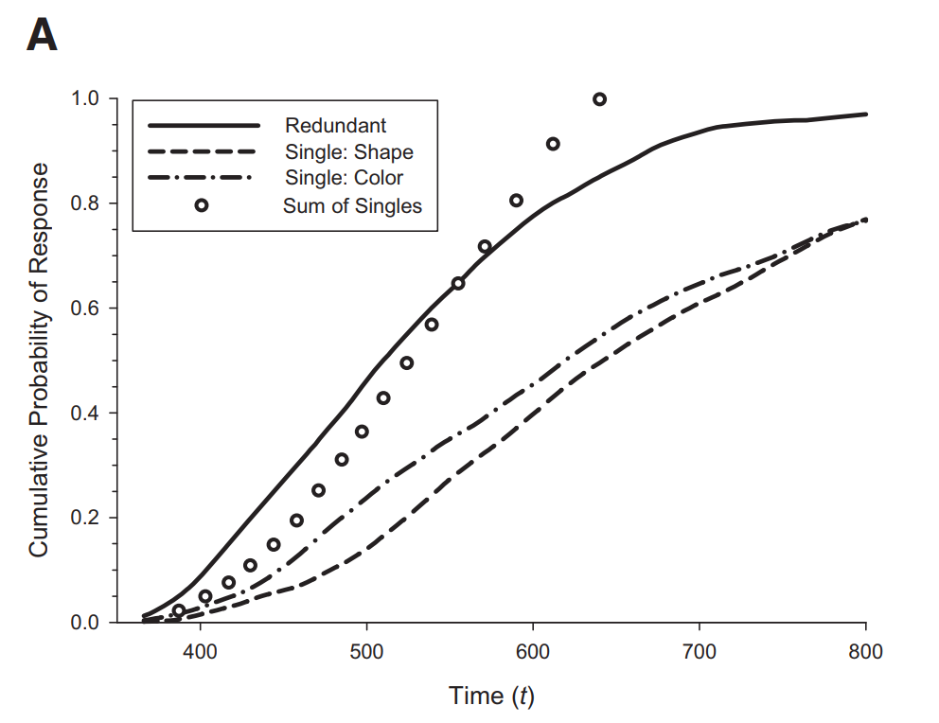
Parallel-coactive model： Violation of RMI
Coactivation
Notes:
所以，如果出现这种violation of RMI，则可以同时拒绝前两个模型

Slide 69
Methods

Slide 70
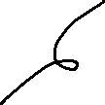
Experiment 1 A&B
integrated cue

Slide 71
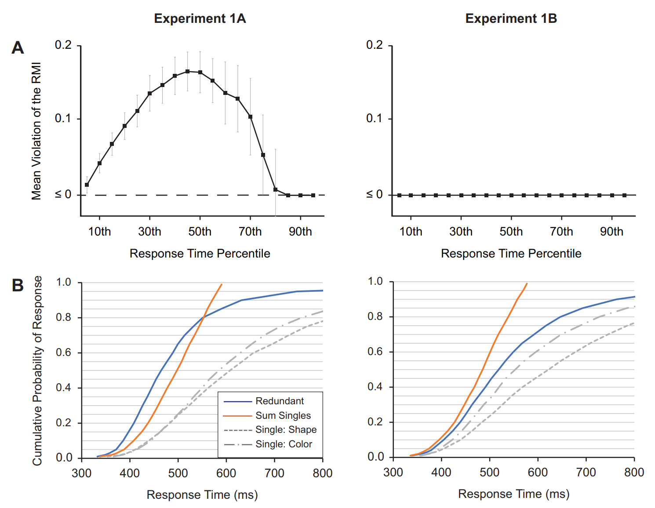
Experiment 1 A&B — Results
Parallel-coactive model
Notes:
只有在search array是redundant 的时候，只有在同一个location上时，才会有priority的叠加加强
注意：这些累积概率分布曲线并不是从0到1的（累积概率分布一定是单调递增的）

Slide 72

Experiment 2
separate cues
Experiment 2.B all present, response to the orientation
Notes:
其实实验一有点模糊不清的一点是，这种integrated cue很容易被看成是一个整合客体
单个的概率会变小，而整合的概率会变大，也可能出现violation of RMI
所以做了实验二，看两个feature的时候实验一的结果是否依旧solid
2B，attention依旧投放在相同的区域，但要判断的东西是正交维度里的

Slide 73
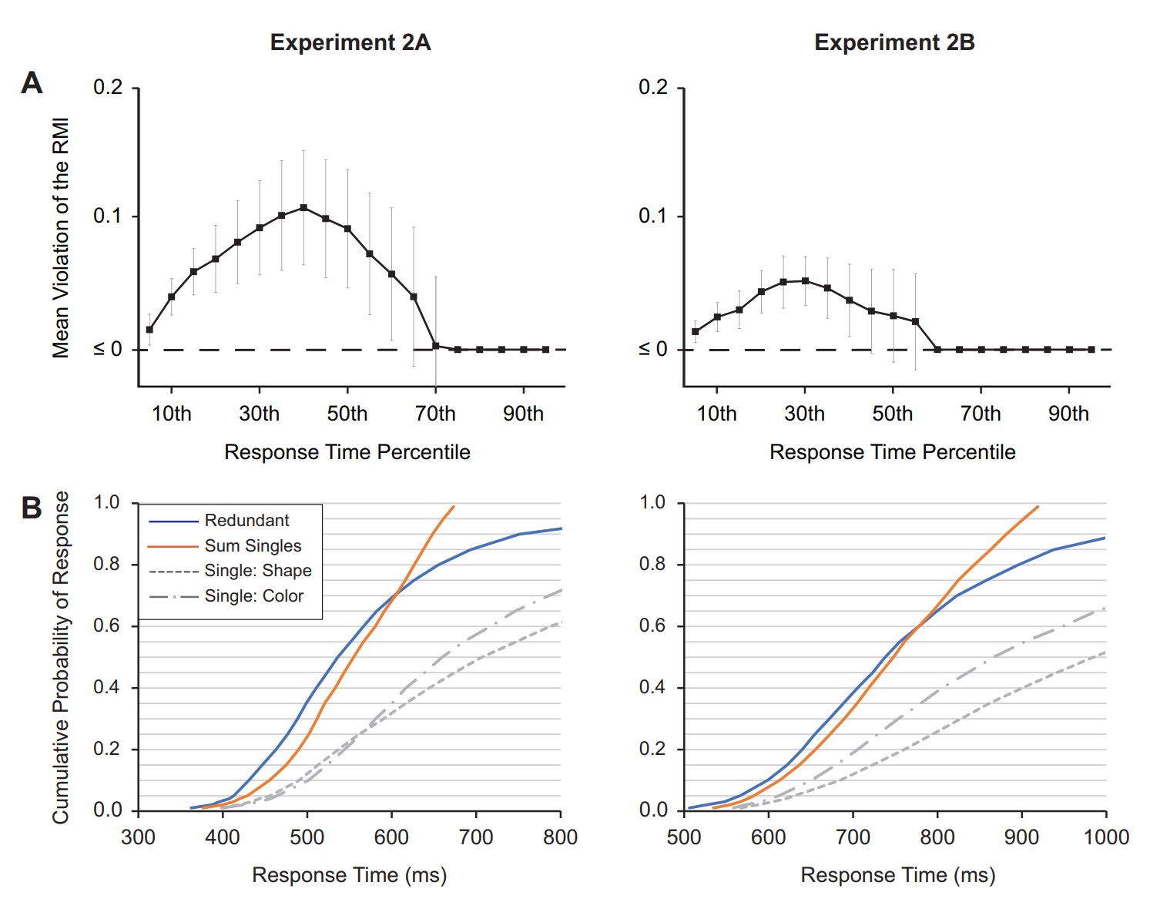
Experiment 2 A&B — Results
Notes:
尽管2B收到了影响，但依旧表现出了相似的模式
排除了single item template的可能

Slide 74


Experiment 3
Notes:
看一下前两个实验是不是因为被试把两个feature 以chunk的形式存储为一个object了，所以实验三选取了来自相同维度的feature，其他同实验2A
右边是可能的两个颜色的放置方式
但是，这样就不会存储成一个object了吗？
在redundant trial里，两种颜色放置的左右位置是随机的，因此不可预测

Slide 75

Experiment 3 — Results

Slide 76
Notes:
证明了两个可以同时引导注意，并且是coactivation model
与之前的redundancy gain相比，改进的地方在于放进了搜索的情境中

Slide 77
Discussion

Slide 78



Review
Switch cost
Attentional capture
Object-switch cost increase with the length of the relevant list, but not with the length of the irrelevant list.
1.1
2.1
Two items stored in WM can capture attention when they are task-irrelevant
SSVEP
Redundancy gain
1.2
2.2
When two memory items were probed simultaneously, visuocortical amplification alternated between the two stimuli at a rate of 3 Hz to 4 Hz
The focus of attention can maintain multiple, independent representations
Notes:
Switch cost 忽略了激活程度绝对值的差异
有研究表明，cue被试其中一个不会被test的话，它不会在之后capture our attention (Hollingworth & Hwang, 2013)
所以其实，focus of attention是可以调整个数的，可以一个也可以两个（当然后面这篇觉得可以是两个）

Slide 79
Review
Coactivation
Fourier Transform
Same location
Notes:
第一个假设两个是独立的，未考虑coactivation的可能；傅里叶转换并不意味着皮质活动真的是存在某种成分
第二个用的是搜索任务，实际上损失了一个很重要的信息：suppression；
同一个位置的局限性；
一直说的activate并不能运用到对神经层面的理解

Slide 80
Question
Coactivation
√
Close
Distant
√
？
Alternation
Notes:
连续变化？距离近就共激活距离远就来回切换？？
过去与未来？？？？？
和则生分则

Slide 81
+

Slide 87
Reference
Bahle, B., Thayer, D. D., Mordkoff, J. T., & Hollingworth, A. (2019). The architecture of working memory: Features from multiple
remembered objects produce parallel, coactive guidance of attention in visual search. Journal of Experimental Psychology.
General.
Cowan, N. (1999). An embedded-process model of working memory: a reconsideration of mental storage capacity. Behavioral and
Brain Sciences, 24, 87-185.
Cowan, N. (2005). Working memory capacity limits in a theoretical context. In Human learning and memory: Advances in theory and
application. The 4th Tsukuba international conference on memory (pp. 155-175).
Dienes, Z., & Mclatchie, N. (2018). Four reasons to prefer Bayesian analyses over significance testing. Psychonomic Bulletin &
Review, 25(1), 207-218.
Di Russo, F., Pitzalis, S., Aprile, T., Spitoni, G., Patria, F., Stella, A., . . . Hillyard, S. A. (2007). Spatiotemporal analysis of the cortical
sources of the steady-state visual evoked potential. Human Brain Mapping, 28, 323–334.
Hollingworth, A., & Beck, V. M. (2016). Memory-based attention capture when multiple items are maintained in visual working memory.
Journal of Experimental Psychology: Human Perception and Performance, 42(7), 911-917.
Mordkoff, J. Toby, & Yantis, Steven. (1991). An interactive race model of divided attention. Journal of Experimental Psychology:
Human Perception and Performance, 17(2), 520-538.
Oberauer, K. (2009). Design for a working memory. Psychology of Learning and Motivation, 51, 45-100.
Oberauer, K. (2002). Access to information in working memory: exploring the focus of attention. Journal of Experimental Psychology:
Learning, Memory, and Cognition, 28(3), 411-421.
Thigpen, N., Petro, N. M., Oschwald, J., Oberauer, K., & Keil, A. (2019). Selection of visual objects in perception and working memory
one at a time. Psychological Science, 30(9), 1259-1272.

